Slide 1
Regulatory challenges: understanding the regulatory maze
On behalf of:
5th March 2024
State of play and possible future developments of the Digital Product Passport (DPP)
Eduard Wagner Fraunhofer IZM
Notes:
MARIO

Slide 2
Evolvement of legislation and information requirements

Slide 3
Evolvement of the DPP From Green Deal to ESPR
Green Deal
Circular Economy Action Plan
Sustainable Product Initative
Projects „PI4.0“, „BP“ „CIRPASS“
Ecodesign for sustainable products Reg. (ESPR)
2019
2024+
“[...] requirements on disclosure of information to market actors along value chains in the form of a digital product passport […] for specific groups of products, [...] such as electronics and textiles [...].”
Notes:
Many DGs are actively contributing to its design and deployment (CNECT, DIGIT, ENER, ENV, GROW, JRC, TAXUD)

Slide 4
Evolvement of the DPP From Green Deal to ESPR
Green Deal
Circular Economy Action Plan
Sustainable Product Initative
Projects „PI4.0“, „BP“ „CIRPASS“
Ecodesign for sustainable products Reg. (ESPR)
Legacy?
2019
2024+
“[...] requirements on disclosure of information to market actors along value chains in the form of a digital product passport […] for specific groups of products, [...] such as electronics and textiles [...].”
Notes:
I want to look into the legal legacy, where the regulatory maze came from and what we can learn from them e.g. when developing the deligated acts

Slide 5
Evolution of legal acts
„Energy Labelling Directive“ 92/75/EC
“Ecodesign Directive” 2009/125/EC
“Textile Regulation” 1007/2011/EU
Product legislation
Corporate legislation
Value chain Stakeholder
Producer, supplier
Producer, supplier
Collection / treatment
Manufacturer
Consumer
Recycler
Substance/ mixture
Article / components
Complex object
ID
Hierarchy
Product unit
Waste (components)
Recycled material
“REACH Regulation” 1907/2006/EC
„CLP Regulation“ 1272/2008/EC
Waste legislation
“Packaging Directive” 94/62/EC
“Battery Directive” 2006/66/EC
“WFD” 2008/98/EC
„RoHS Directive“ 2011/65/EU
“WEEE Directive” 2012/19/EU
Chemical legislation
Notes:
Missing information requirements and exemptions
Not available
Not usable (format, granularity, accessability)
interoperable,
not standardised
Not accessible

Slide 6
Project PI4.0 analysis approach

Slide 7
Overview information requirements in legal acts
Legal area | Description | Material information | Functional and technical spec. | Product design information | Circularity information
Chemicals legislation | “REACH Regulation” (EC) No 1907/2006 on the Registration, Evaluation, Authorisation and Restriction of Chemicals | x
 | Regulation (EC) No 1272/2008 on the classification, labelling and packaging of substances and mixtures “CLP Regulation” | x
Product legislation | “Textile Regulation” (EU) No 1007/2011 on textile fibre names and related labelling and marking of the fibre composition of textile products | x
 | “Ecodesign Directive” 2009/125/EC establishing a framework for the setting of ecodesign requirements for energy-related products |  | x | x | x
 | Example: Commission Regulation (EU) No 617/2013 with regard to ecodesign requirements for computers and computer servers |  | x | x
 | Example: Commission Regulation (EU) 2019/2023 laying down ecodesign requirements for household washing machines and household washer-dryers |  | x | x
 | Example: Commission Regulation (EU) 2019/2021 laying down ecodesign requirements for electronic displays “Ecodesign Regulation Displays” | X | x | x
 | “EEL Regulation” (EU) 2017/1369 setting a framework for energy labelling |  | x | x
 | “ESPR Regulation” framework for setting Ecodesign Requirements for Sustainable Products, COM(2022) 142 final, 2022/0095(COD) | X | x | x | x
 | “Circular Textiles Strategy” EU Strategy for Sustainable and Circular Textiles ( COM(2022) 141 final) |  |  | x | x
 | “Type Approval Regulation ”Regulation (EU) 2018/858 on the approval and market surveillance of motor vehicles and their trailers, and of systems, components and separate technical units intended for such vehicles |  | x | x
Waste legislation | “Battery Directive” Directive 2006/66/EC on batteries and accumulators and waste batteries and accumulators | x |  |  | x
 | “Battery Regulation” Regulation (EU) 2023/1542 concerning batteries and waste batteries | x | x | x | x
 | “ELV Directive” Directive 2000/53/EC on end-of life vehicles | x |  | x
 | “Packaging Directive” Directive 94/62/EC on packaging and packaging waste |  | x | x
 | “WEEE Directive” Directive 2012/19/EU on waste electrical and electronic equipment | x |  | x
 | “WFD Directive ”Directive 2008/98/EC on waste (Waste Framework Directive) | x |  |  | x
 | Directive 2011/65/EU on the restriction of the use of certain hazardous substances in electrical and electronic equipment “RoHS Directive” | x
Corporate legislation | “CSDD Proposal” Proposal for a Directive on Corporate Sustainability Due Diligence, COM(2022) 71 final, 2022/0051(COD) |  |  |  | x
 | Regulation (EU) 2017/821 on supply chain due diligence “Conflict Mineral Regulation”, “CMR” | x

Slide 8
Evaluation of legal acts
26 Expert interviews
5 Workshops
Consumer survey (1001 particpants)

Slide 9
Evaluation of legal acts
26 Expert interviews
5 Workshops
Consumer survey (1001 particpants)
1. Legal information requirement exists?
Legal information gap
no
2. Is the information available?
Availability gap
yes
no
3. Is the information usable?
Usage barrier
Accessibility
Format
Granularity
yes
no
No barrier (information is available and usable)
yes
Notes:
First conclusion: Only few missing information requirements. BUT: Gaps and barriers mostly occur due to missing definitions of:
Accessibility e.g. Website, API
Format e.g. analog (icon, label/text) or digital (pdf, html)
Granularity e.g. specific threshold; percent, absolute, binary
Data provider, target data user
Information gap (not existing or exemptions in legis.)
Availability gap (not available to target stakeholder)
Usability Barrier (not usable by target stakeholder)
Accessibility
Format
Granularity

Slide 10
Project PI4.0 results

Slide 11
Information related gaps and barriers: REACH Regulation
Value chain Stakeholder
Producer, supplier
Producer, supplier
Collection / treatment
Manufacturer
Consumer
Recycler
Substance/ mixture
Article / components
Complex object
ID
Hierarchy
Product unit
Waste (components)
Recycled material
“REACH Regulation” 1907/2006/EC:
Identification of articles containing SVHCs above 0.1%
Notes:
Missing information requirements and exemptions
Not available
Not usable (format, granularity, accessability)
interoperable,
not standardised
Not accessible

Slide 12
Information related gaps and barriers: REACH Regulation
Value chain Stakeholder
Producer, supplier
Producer, supplier
Collection / treatment
Manufacturer
Consumer
Recycler
Substance/ mixture
Article / components
Complex object
ID
Hierarchy
Product unit
Waste (components)
Recycled material
“REACH Regulation” 1907/2006/EC:
Identification of articles containing SVHCs above 0.1%
Information gap (exemptions)
Usage barriers (accessability)
Availability gap
(not complete)
Notes:
Material related information:
Legal information gaps in REACH, Textile legislation
Most present usage barrier for Waste Treatment operators is accessability (platforms) and granularity (only material tresholds)
Missing information requirements due to exemptions: additives, impurities → Materials that inhibit circularity
Not available → SCIP not complete, missing entries
Not usable (
Format: WEbiste
Granularity: concentration
Accessability: via API
interoperable,
not standardised
Not accessible

Slide 13
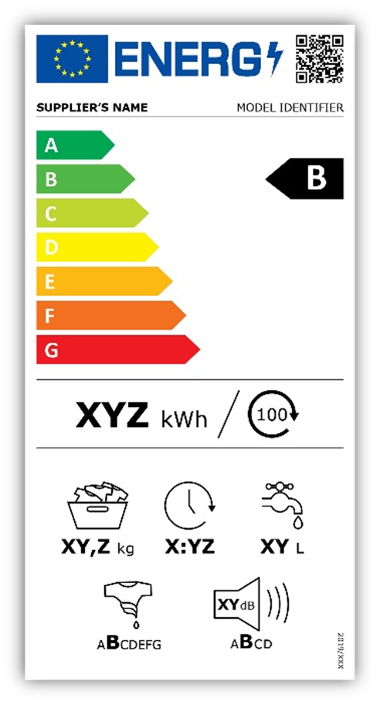
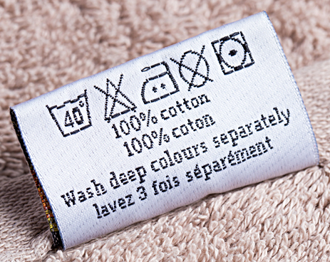
Information related gaps and barriers: product legislation
„Energy Labelling Directive“ 92/75/EC
“Ecodesign Directive” 2009/125/EC
“Textile Regulation” 1007/2011/EU
Information gaps
(exemptions)
Usage barrier (format)
Value chain Stakeholder
Producer, supplier
Producer, supplier
Collection / treatment
Manufacturer
Consumer
Recycler
Substance/ mixture
Article / components
Complex object
ID
Hierarchy
Product unit
Waste (components)
Recycled material
Notes:
Most common usage barrier for consumer is the format (icons)
For product related information biggest usage barriers is accessability to repair/dissassambly information for repairers and waste treatment
Missing information requirements and exemptions
Not available
Not usable (format, granularity, accessability)
interoperable,
not standardised
Not accessible

Slide 14
Information related gaps and barriers: product legislation
„Energy Labelling Directive“ 92/75/EC
“Ecodesign Directive” 2009/125/EC
“Textile Regulation” 1007/2011/EU
Information gaps
(exemptions)
Usage barrier (accessability)
Value chain Stakeholder
Producer, supplier
Producer, supplier
Collection / treatment
Manufacturer
Consumer
Recycler
Repair
Substance/ mixture
Article / components
Complex object
ID
Hierarchy
Product unit
Waste (components)
Recycled material
Waste legislation
“Packaging Directive” 94/62/EC
“Battery Directive” 2006/66/EC
“WFD” 2008/98/EC
„RoHS Directive“ 2011/65/EU
“WEEE Directive” 2012/19/EU
Usage barrier (accessability)
Notes:
For product related information biggest usage barriers is accessability to repair/dissassambly information for repairers and waste treatment
Missing information requirements and exemptions
Not available
Not usable (format, granularity, accessability)
interoperable,
not standardised
Not accessible

Slide 15
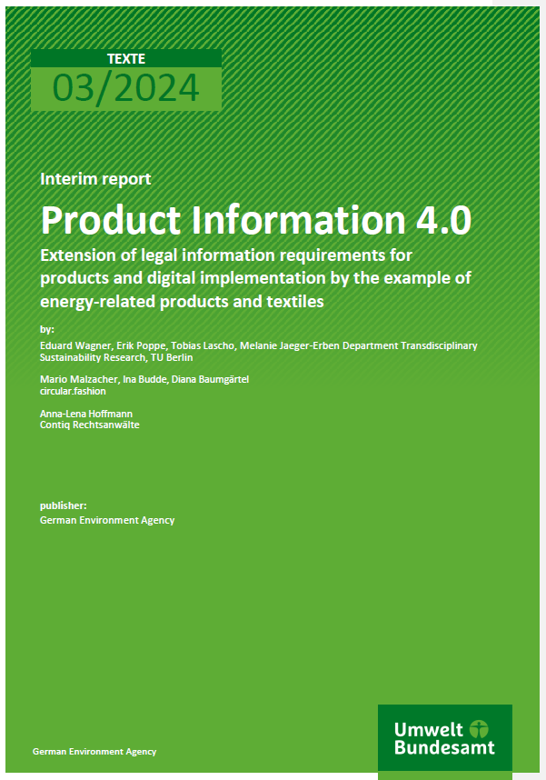
Comprehensive evaluation overview available in report
Legal act | Information requirement and granularity | Target information user | Access/ format | Legal information gap | Availability gap | Format | Accessability | Granularity | Stakeholder evaluation
REACH Regulation (Art. 33) | Identification of articles containing an SVHC above 0.1% | Recipient of the article | SCIP database (requirement of the WFD Directive) | X | X | X |  | (X) | …
Textile Regulation | Textile fibre name and composition of each component (above 5-15%) | Consumer | Labels | X |  |  |  | X
 |  |  |  | X |  | X

Slide 16
Conclusions
Only few missing information requirements mainly material.
BUT: Gaps and barriers mostly occur due to missing specification of:
Accessibility e.g. Website, API
Format e.g. analog (icon, label/text) or digital (pdf, html)
Granularity e.g. specific threshold; percent, absolute, binary
Data provider, target data user
Most improvement potential (through the DPP) seen in
Better access and more (granular) material information for recyclers and consumers
Common usage barrier for consumer: format (icons)
More circularity and detailed on-demand information for consumers
For product related information biggest usage barriers is accessability to repair/dissassambly information for repairers and waste treatment
Accessability to structured information on repair/disassembly for repairers and recyclers
DPP further enables technically related aspects → second PI4.0 presentation
Legal information gaps partially tackled by ESPR, some recommendations presented in → third PI4.0 presentation
Notes:
(More aspects and meta data can be found e.g. in “FAIR principles”)

Slide 17
Regulatory challenges
Fraunhofer IZM (/TU Berlin)
Eduard Wagner
eduard.wagner@izm.fraunhofer.de
Gustav-Meyer-Allee 25
13355 Berlin, Germany
circular.fashion
Mario Osterwalder
E-Mail: mario@circular.fashion
Contiq Rechtsanwaltsgesellschaft
Dr. Anna-Lena Hoffmann
E-Mail: hoffmann@contiq.de
Notes:
Only few missing information requirements. BUT: Gaps and barriers mostly occur due to missing definitions of:
Accessibility e.g. Website, API
Format e.g. analog (icon, label/text) or digital (pdf, html)
Granularity e.g. specific threshold; percent, absolute, binary
Data provider, target data user
Most improvement potential seen in
Material information such as hazardous substances or substances of concern for recyclers and consumers
Circularity and on-demand information for consumers
Repair/disassembly information for repairers and recyclers
DPP further enables technically related aspects → second PI4.0 presentation
Legal information gaps partially tackled by ESPR, some recommendations presented in → third PI4.0 presentation

